Slide 1
COMMUNICATION AND DATA CENTER BACK-UP POWER SYSTEMS
The Good, The Bad, and The Ugly
Daniel Ashton
SR Operations Engineer Lumen Technologies

Slide 2
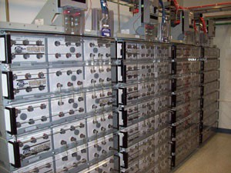
Traditional Power Systems Review
- 48 V DC With Battery Back- up (Energy Storage)
Back-up Generation With Automatic Transfer Switch
Inverters for isolated AC power

Slide 3
Uninterruptible Power Supply Systems
UPS Basic Design
Redundancy
Maintenance
Advanced Designs
A Plethora of choices
The Good
The Bad and the Ugly

Slide 4
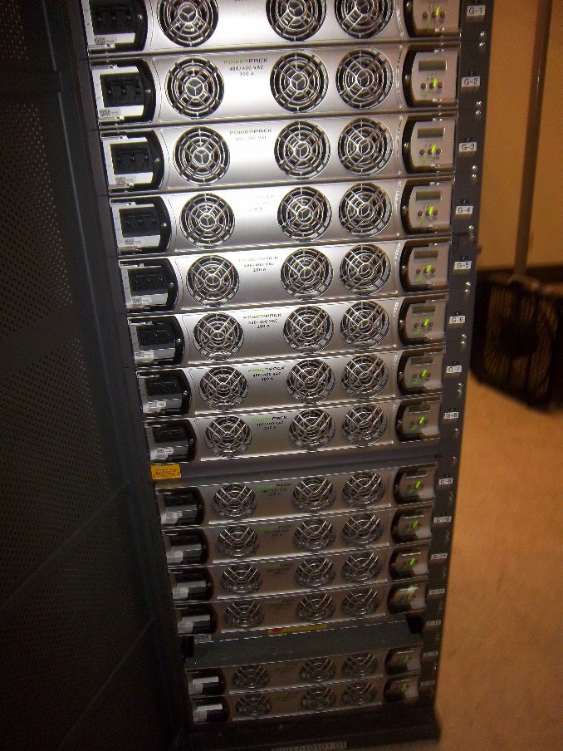
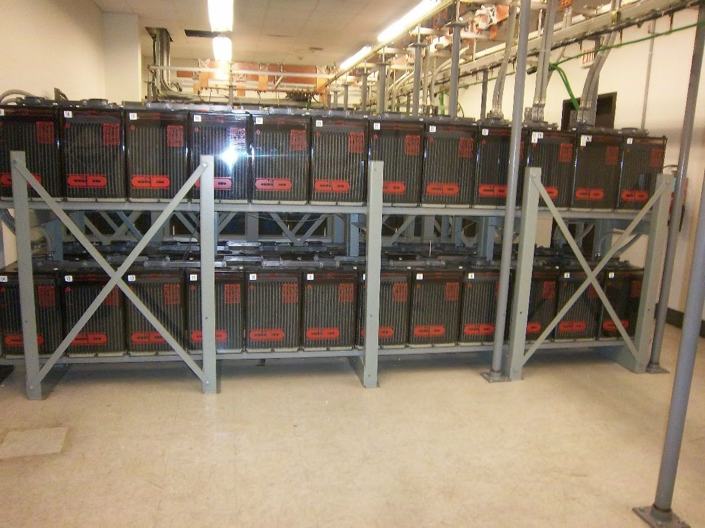
- 48V DC Power,
The Historical Choice of Telcom

Slide 5
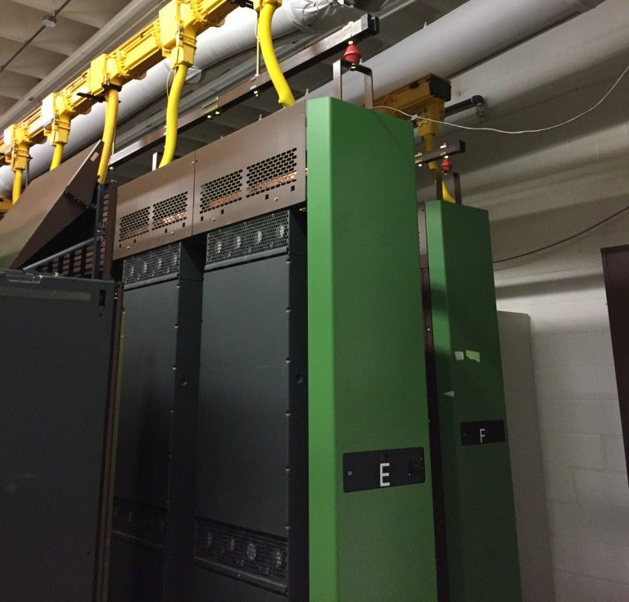
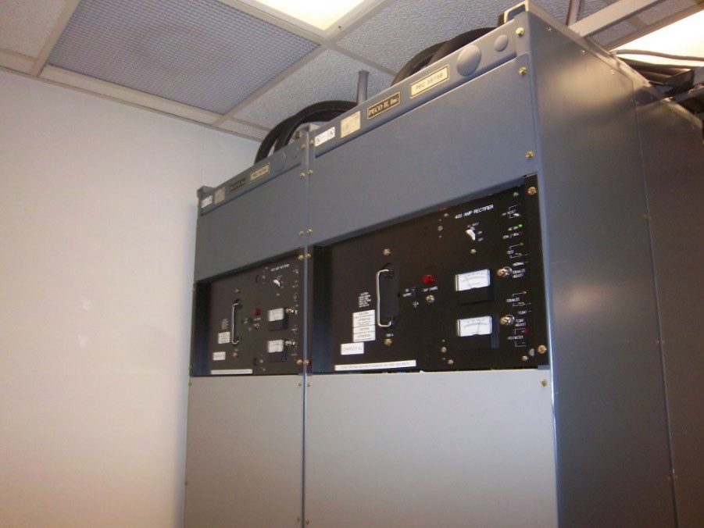
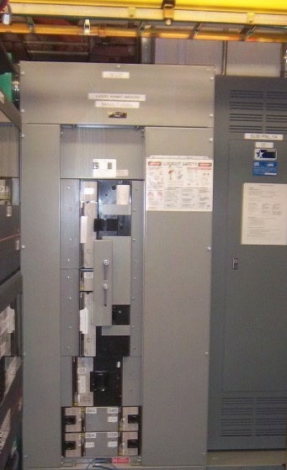
DC Power example, no back-up generator.
DC “LOAD”
AC MAINS
DC RECTIFICATION
AC BREAKERS
ENERGY STORAGE

Slide 6
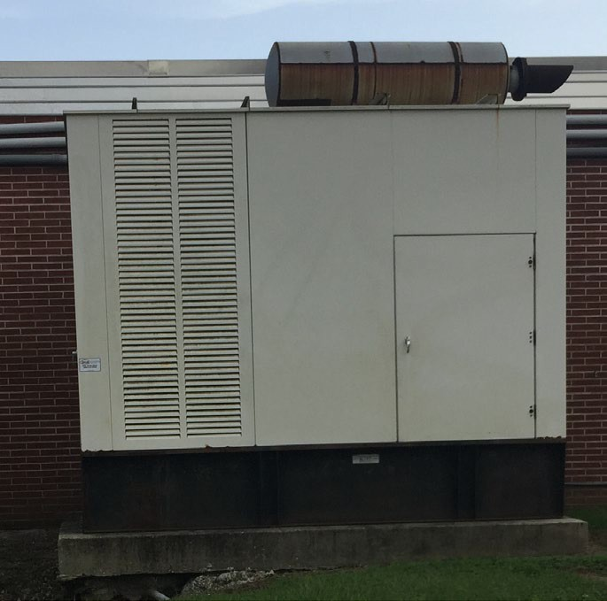
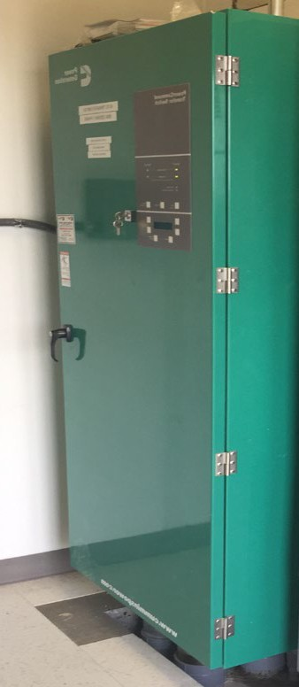
DC Power example, back-up generator.
DC “LOAD”
ENERGY STORAGE
DC RECTIFICATION
AC BREAKERS
Back-up Generation
AC MAINS
Automatic Transfer Switch

Slide 7
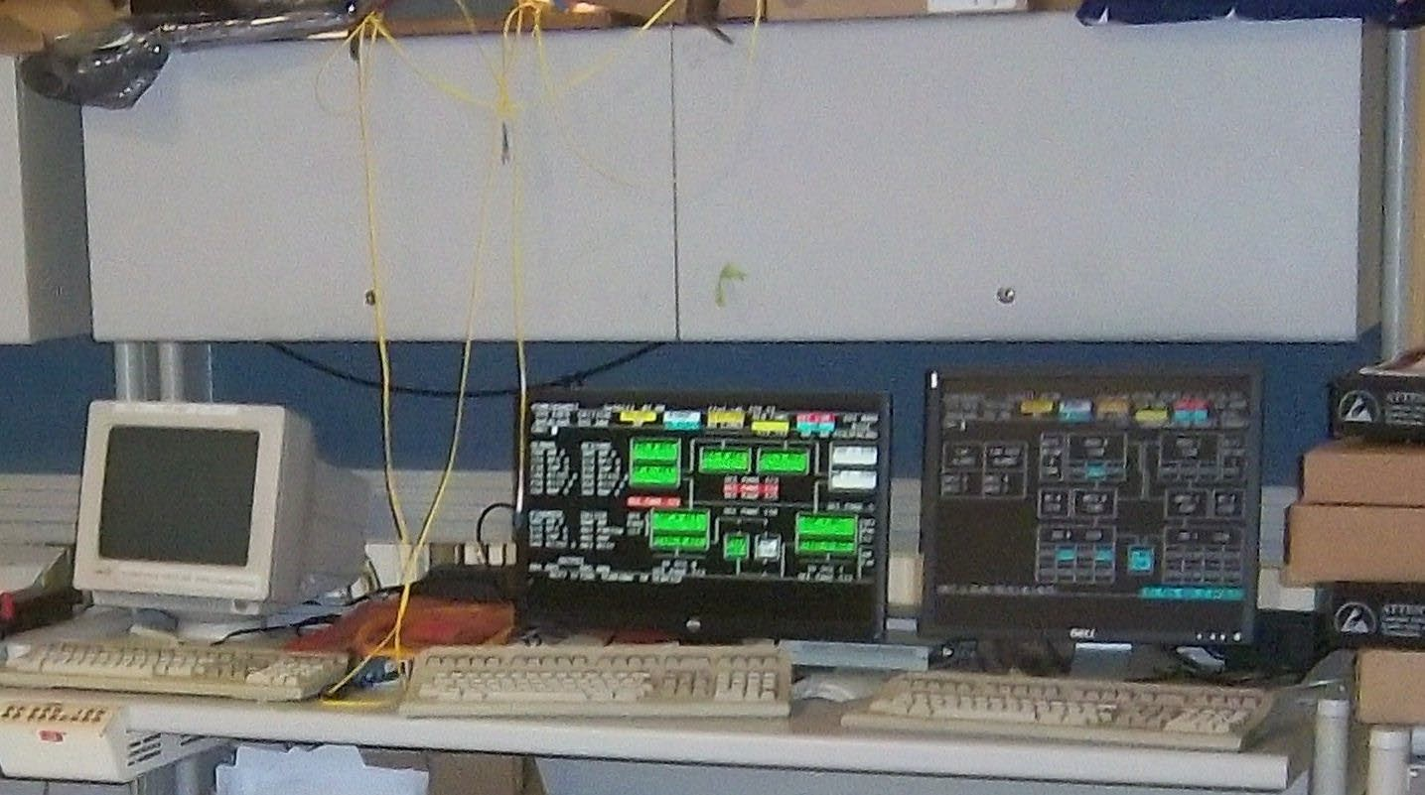
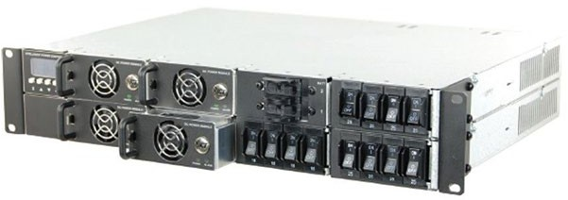
Traditional use of Inverters
Digital Voice Switch Workstation
-48V DC
120V AC
Digital Voice Switch in Isolated Zone

Slide 8
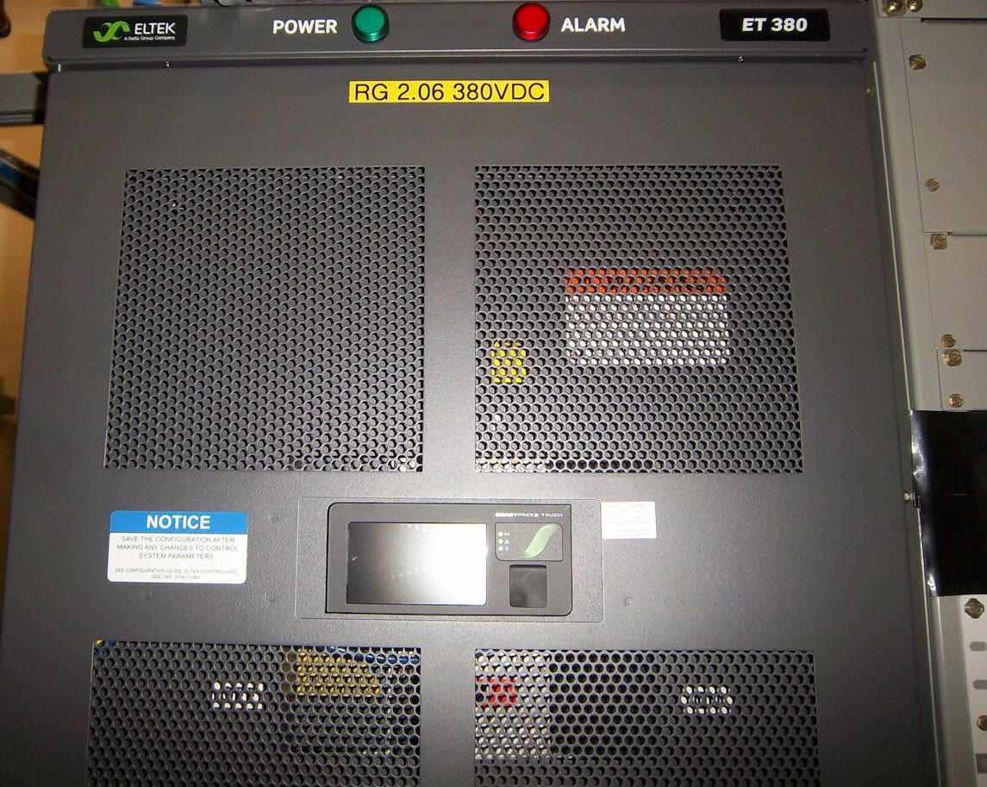
380V DC Power systems for Communication or Data Centers
There has been a lot of discussion concerning the benefits of a 380V DC power system in recent years. There may be cost savings in reduced energy consumption and reduced intermediate power conversions equipment IF the data center is designed from its inception for this type of power.

Slide 9
380V DC Power systems for Communication or Data Centers
Where a 380V DC power system is added to a Communication/ Data Center, additional power conversion equipment may be required which increases capital outlay and routine maintenance costs.
Careful consideration and advanced planning should be utilized when considering which form of DC power will be used for a given location.

Slide 10
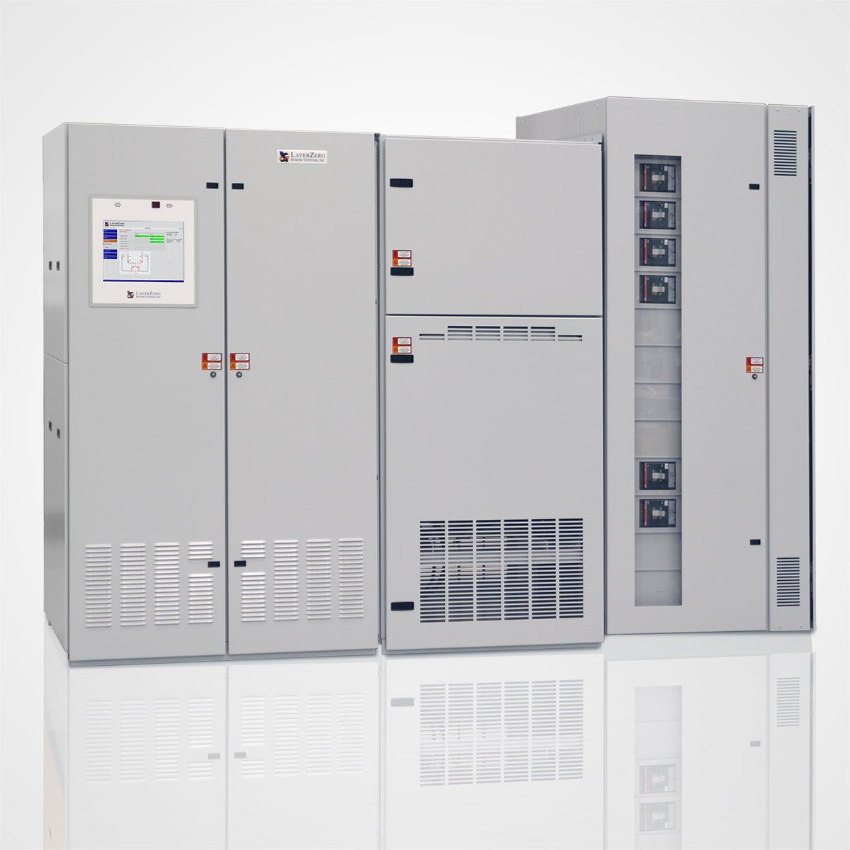
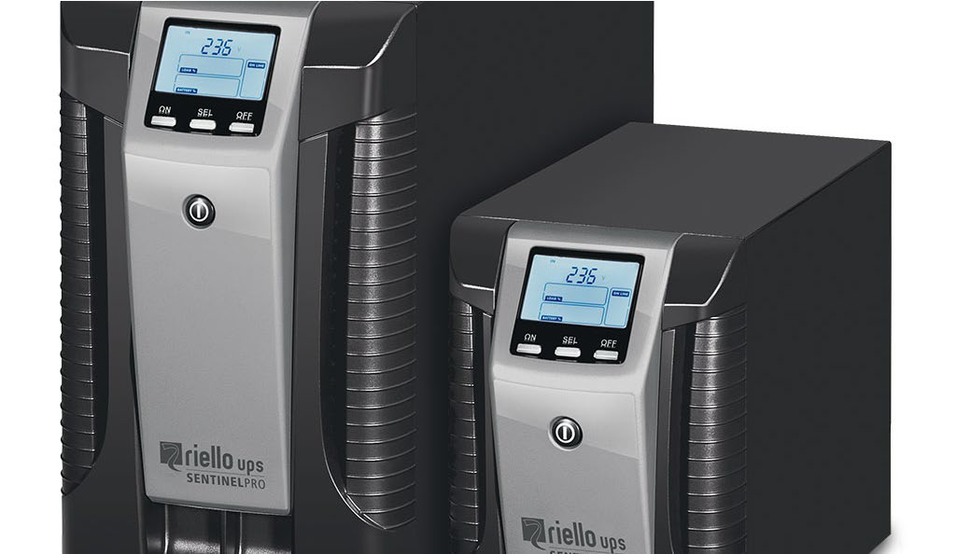
Uninterruptible Power Supply (UPS)
UPS systems come in sizes ranging from a few hundred Watts @ 120 VAC to the world's largest UPS, the 46- megawatt Battery Energy Storage System (BESS) in Fairbanks, Alaska. This UPS powers the entire city and nearby rural communities during commercial power outages.
From this
To this
and beyond

Slide 11
UPS, how does it work?
In its most simple form, a UPS system converts AC power to DC power, terminates energy storage (batteries and or “super” capacitors) onto the DC buss, then converts the DC power to AC power which supplies any attached loads.
During a loss of AC power input, the batteries become the power source for the DC to AC conversion which continues to provide power to the attached loads.
Depending on battery capacity and output load, the UPS can maintain power from a few minutes to multiple hours.

Slide 12
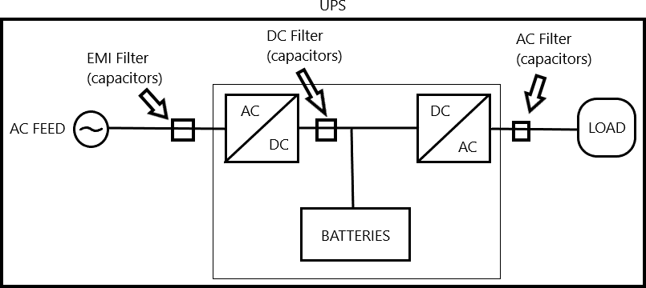
UPS Design, a Slightly More In-Depth Look
Due to the AC/DC, DC/AC conversion process, capacitors are needed for several reasons.
Filtering harmonics and voltage stabilization among them.
The result of capacitor filtering, under normal operations, is a very stable AC voltage and current delivery to the “protected” load.

Slide 13
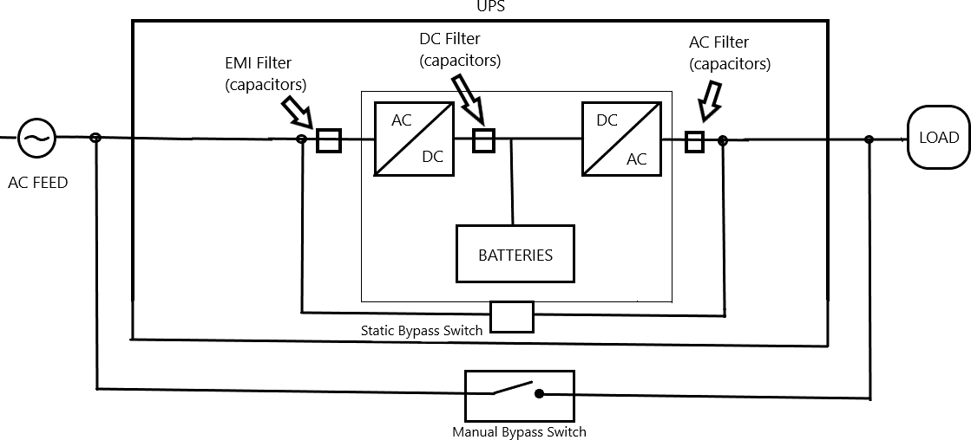
UPS Design, additional components
To protect the critical loads during a failure of the UPS system, there is a static bypass switch that will automatically switch the power feed around the internal power conversions of the UPS. This prevents a loss of power to the load.
In some installations, a manual bypass may also be installed. This provided a means to route the power to the load around the UPS for servicing and maintenance work.
Anytime a system is by-passed, the critical load is considered un-protected.

Slide 14
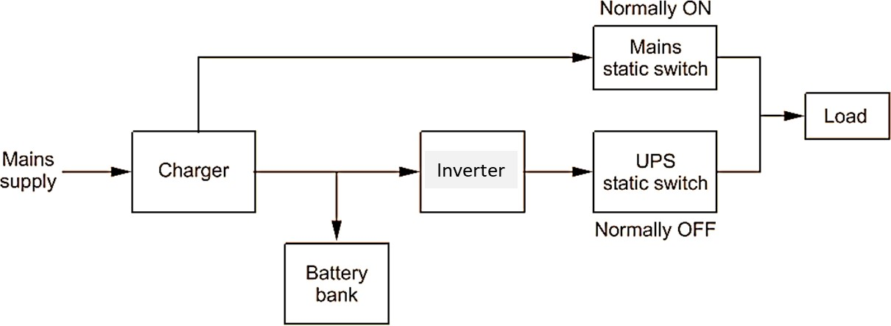
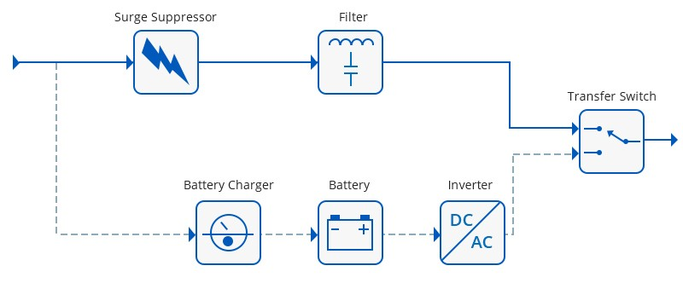
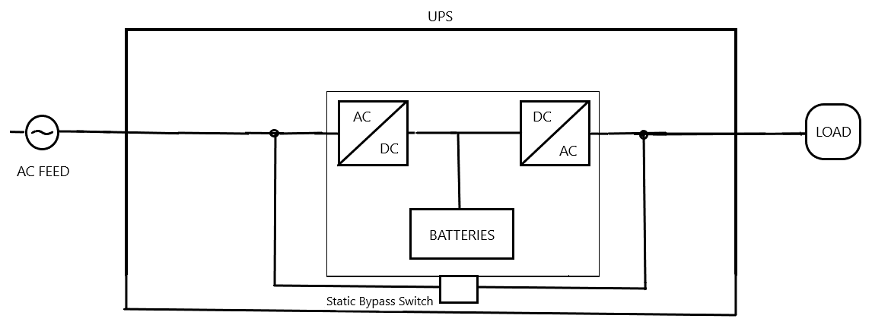
There are 3 levels (modes) of UPS operation.
UPS Modes of Operation
On-line double conversion (the most common for Communication and Data Centers)
Line Interactive
Offline/Line Preferred

Slide 15
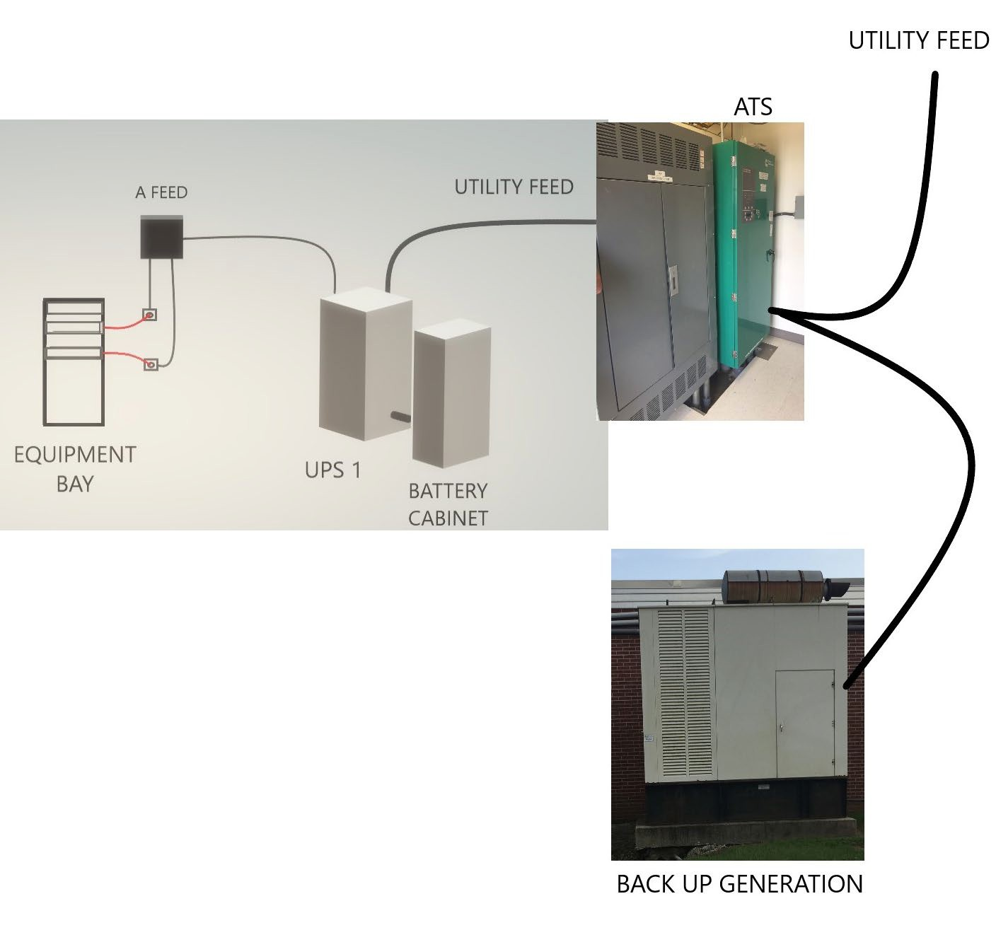
UPS SYSTEMS PREDOMINANT CONFIGURATION IN DATA AND COMMUNICATIONS CENTERS
In most cases, the UPS system is used primarily as a “bridge” to maintain power to the critical loads between the loss of the Utility power feed and the back-up generation to be initiated and switched through the automatic transfer switch (ATS).
As demonstrated earlier, a side benefit is a more stable power supplied to the critical load.

Slide 16
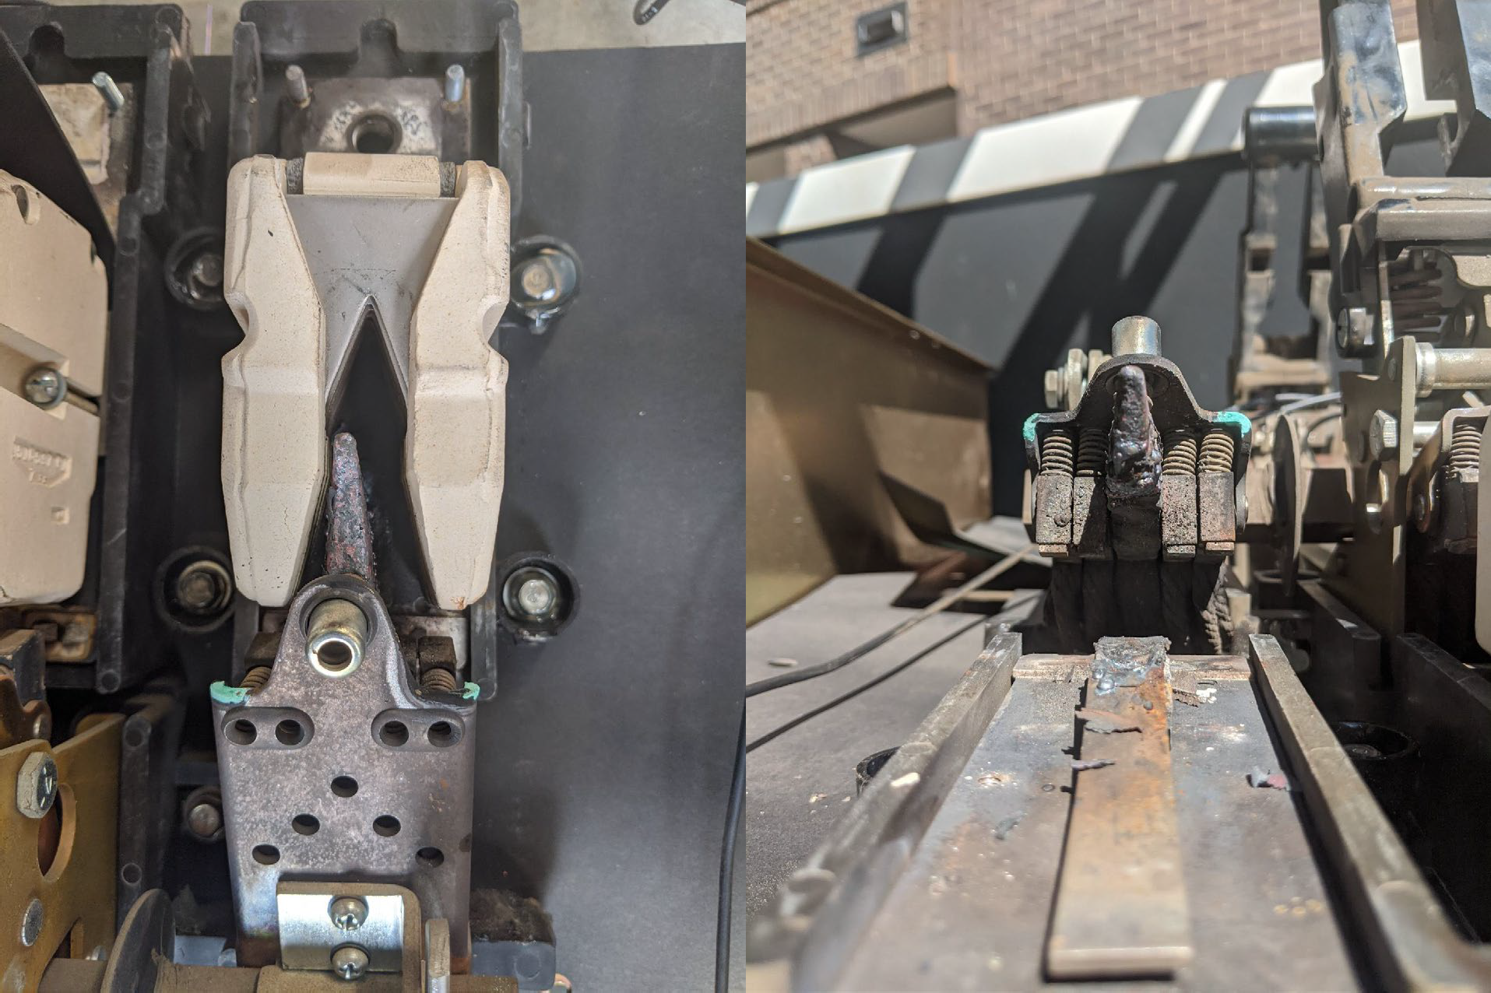
Preventive Maintenance
Routine visual and thermal inspections of an ATS can prevent failures like the one shown here. The loss of phase during a transfer to the back-up generator, caused extensive damage through out the facility served by the ATS.

Slide 17
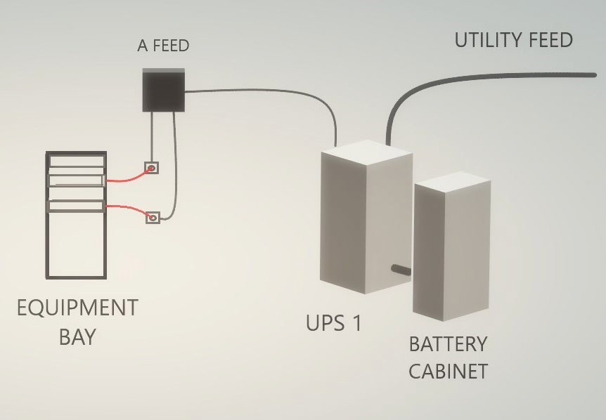
UPS SYSTEM DESIGNS SINGLE FEED
In its simplest form, this single feed UPS system provides AC power to the critical load with no redundancy. If the UPS fails, the power to the load may be interrupted.

Slide 18
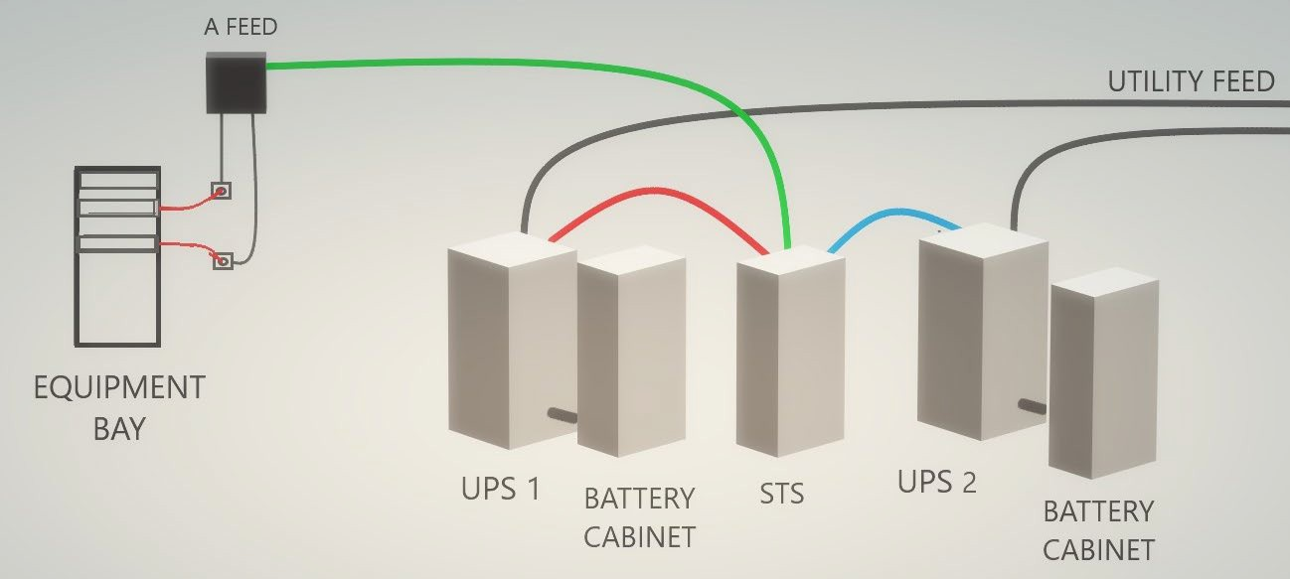
UPS SYSTEM DESIGNS SINGLE FEED
There are multiple ways to add redundancy to a UPS system. This example provided redundancy through a static transfer switch (STS). This allows continuous power to the critical load if the primary UPS fails by automatically switching to the secondary UPS.

Slide 19
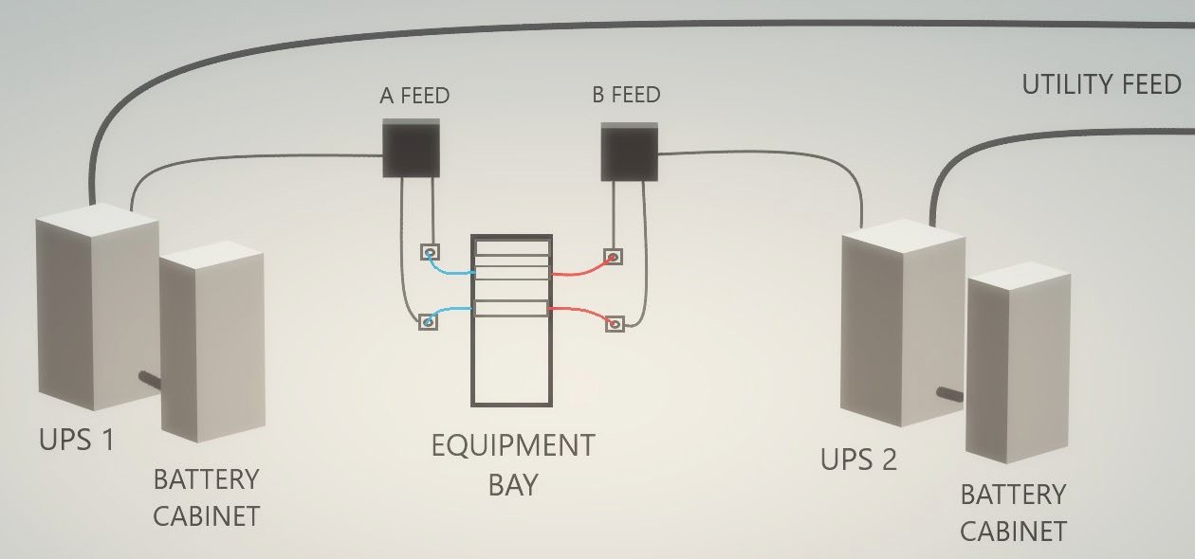
UPS SYSTEM DESIGNS DUAL FEED
Another way to add redundancy is shown here. This method is similar to a traditional redundant DC power system as it provides an A and B source to the critical load.

Slide 20
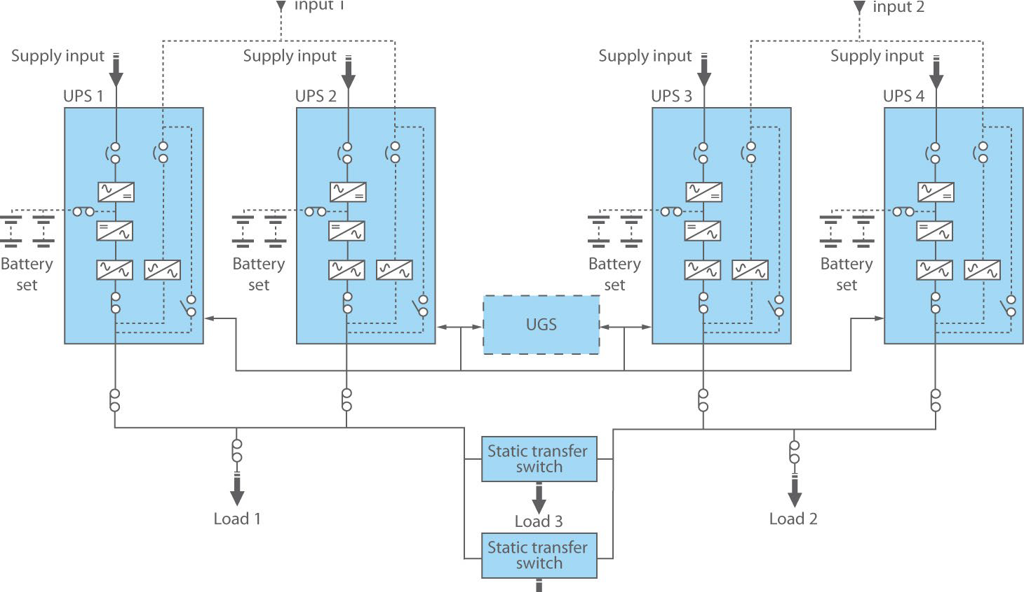
UPS SYSTEM DESIGNS DUAL FEED
UPS system designs can be complex. This example utilizes 2
utility feeds, 4 UPSs, 2 STS, and a UPS Group Synchronizer (UGS). A UGS is a control device that regulates the outputs from two separate groups of UPS systems operating in parallel, even if they are supplied from different AC power sources.
Load 4

Slide 21
Dual Utility Feeds
2 Back-up Generators with room for expansion
Example of an electrical “one line” drawing of a data center.
This is a great
example of the complexities that can be designed into a back-up power system.
Tie Breaker
Tie Breaker
UPS-C ATS
UPS-A
UPS-B
UPS-C

Slide 22
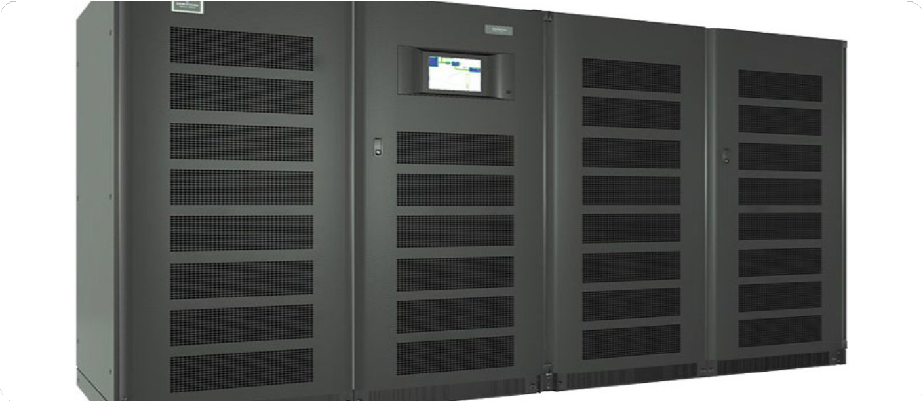
UPS SYSTEM DESIGN/ SYSTEM SIZING
Incorrectly sizing a UPS system can be costly. Many systems are built with a “if you build it, they will come” mentality. It’s much more cost affective to add to a system as demand increases than to build an over sized system with all of the inherent maintenance issues that comes with it.

Slide 23
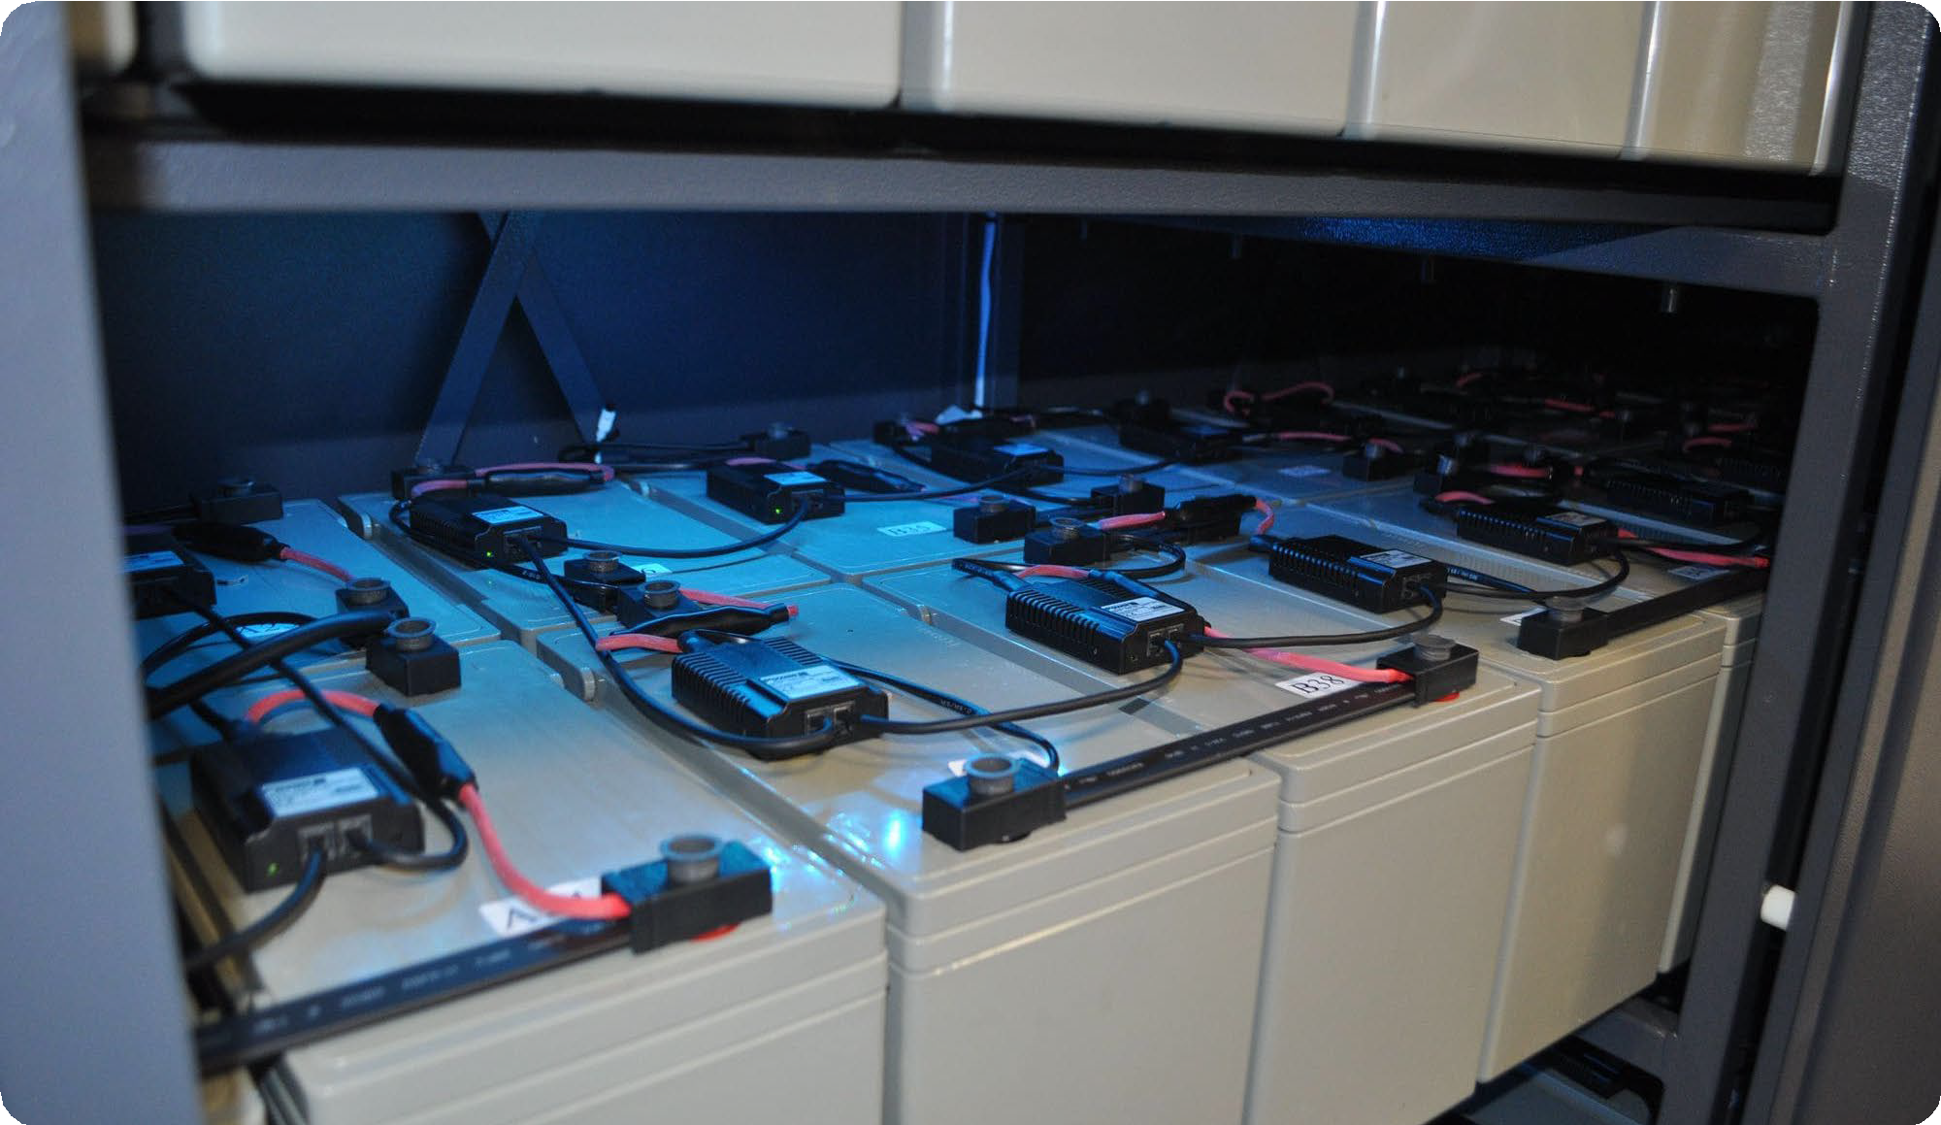
UPS BATTERY RESERVE
UPS batteries can be the most long- term expense incurred in a UPS system.
Depending on size (watts /cell or Amp hour rating), a 40- jar string can cost upwards of $18K.

Slide 24
UPS BATTERIES
If you design the UPS battery reserve as a means of carry-over power to the critical load until the back-up generator comes on-line, 15 minutes reserve is a good rule of thumb. This is also cost effective when additional battery installations or replacements are required.

Slide 25
UPS BATTERIES
Adding battery strings can greatly increase the reserve time, HOWEVER, is it a cost affective design for the over-all system?

Slide 26
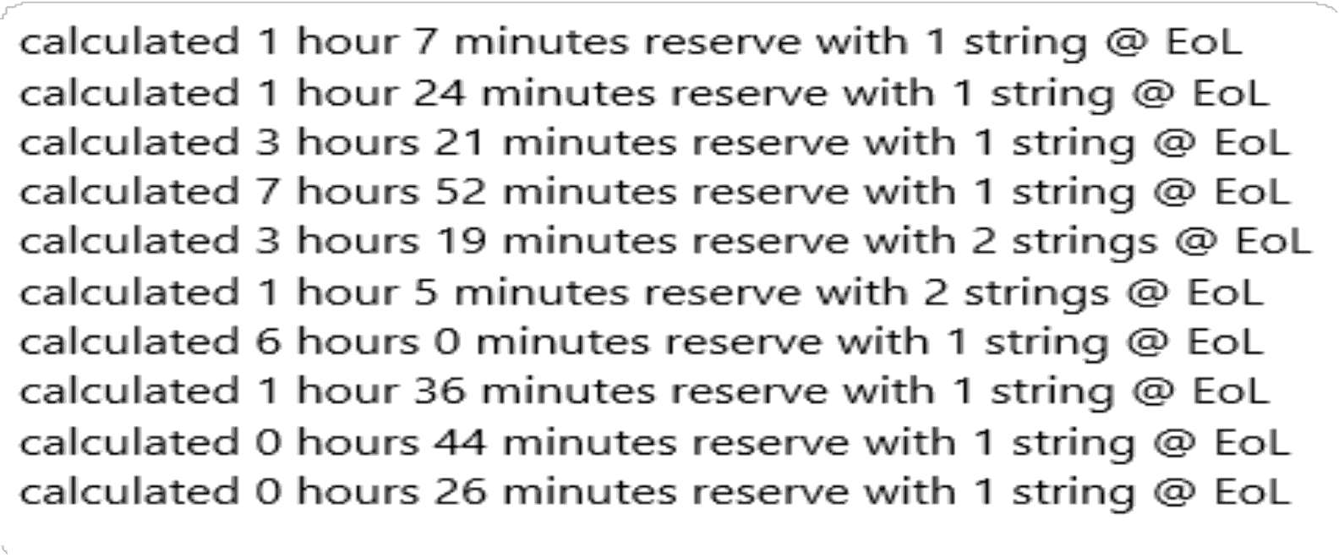
UPS BATTERIES
Real examples of the varying degrees of battery reserve time based on UPS output load and battery string configuration.

Slide 27
UPS BATTERIES
If planning on a 15-minute reserve time, the bottom string is the best return on investment.

Slide 28
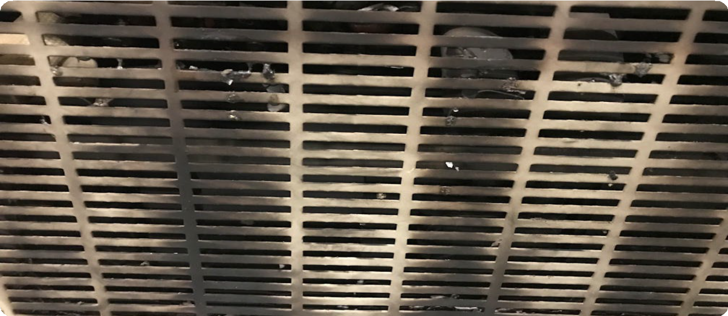
UPS Maintenance- the BAD and the UGLY
Due to the complexity of the UPS equipment, routine maintenance is critical for maintaining system reliability.

Slide 29
UPS Maintenance- the BAD and the UGLY
A UPS system can account for 13% or more of the total heat load in a facility. VRLA batteries and capacitors within the UPS, will have a shortened life span IF the area where the UPS system resides is not kept cool. Generally, the low 70’s (degrees F) will keep the components cool enough not to affect their designed life cycle.

Slide 30
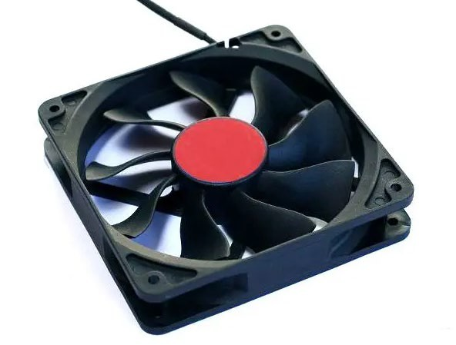
UPS Fans and Filters
UPS fans play a vital role in keeping electronic components cool enough to operate safely. Air filters must also be checked regularly. If the internal UPS fans don't work properly or air filters become clogged, UPS components run at much higher temperatures, which reduces their overall lifespan.

Slide 31
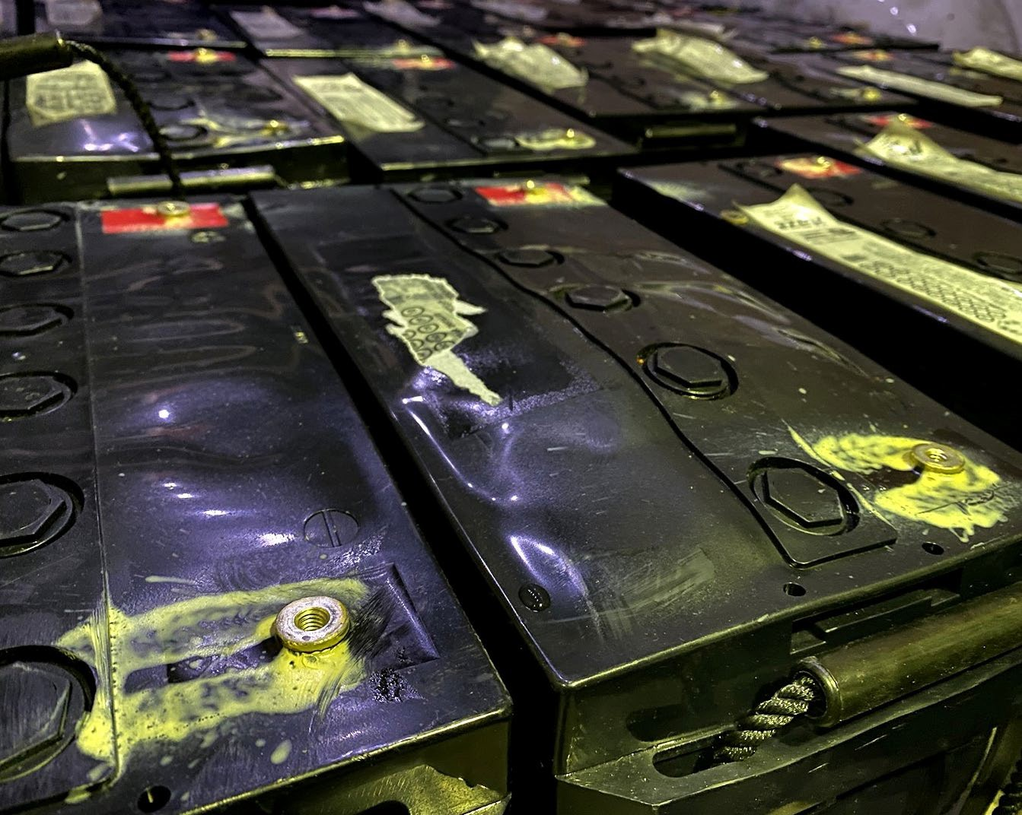
Batteries, One of the Most Common Causes of UPS System Failures.
At the heart of every UPS system are batteries which require regular checkups to ensure they remain fit to protect critical loads.
Regardless of their age, batteries should be inspected semi-annually as part of a PM visit that includes testing for impedance or conductance, as well as jar voltage which can help you evaluate any potential weaknesses.

Slide 32
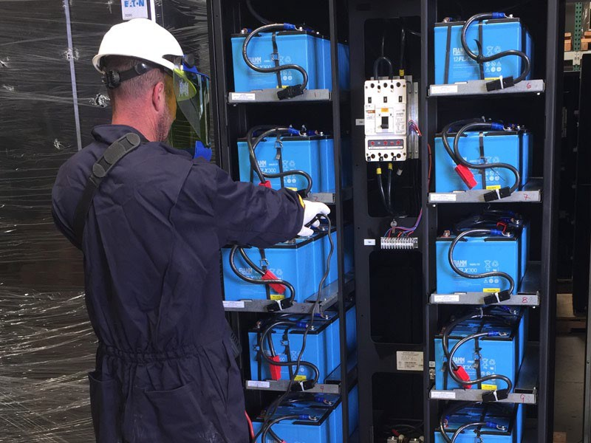
Batteries, One of the Most Common Causes of UPS System Failures.
A lack of this…

Slide 33
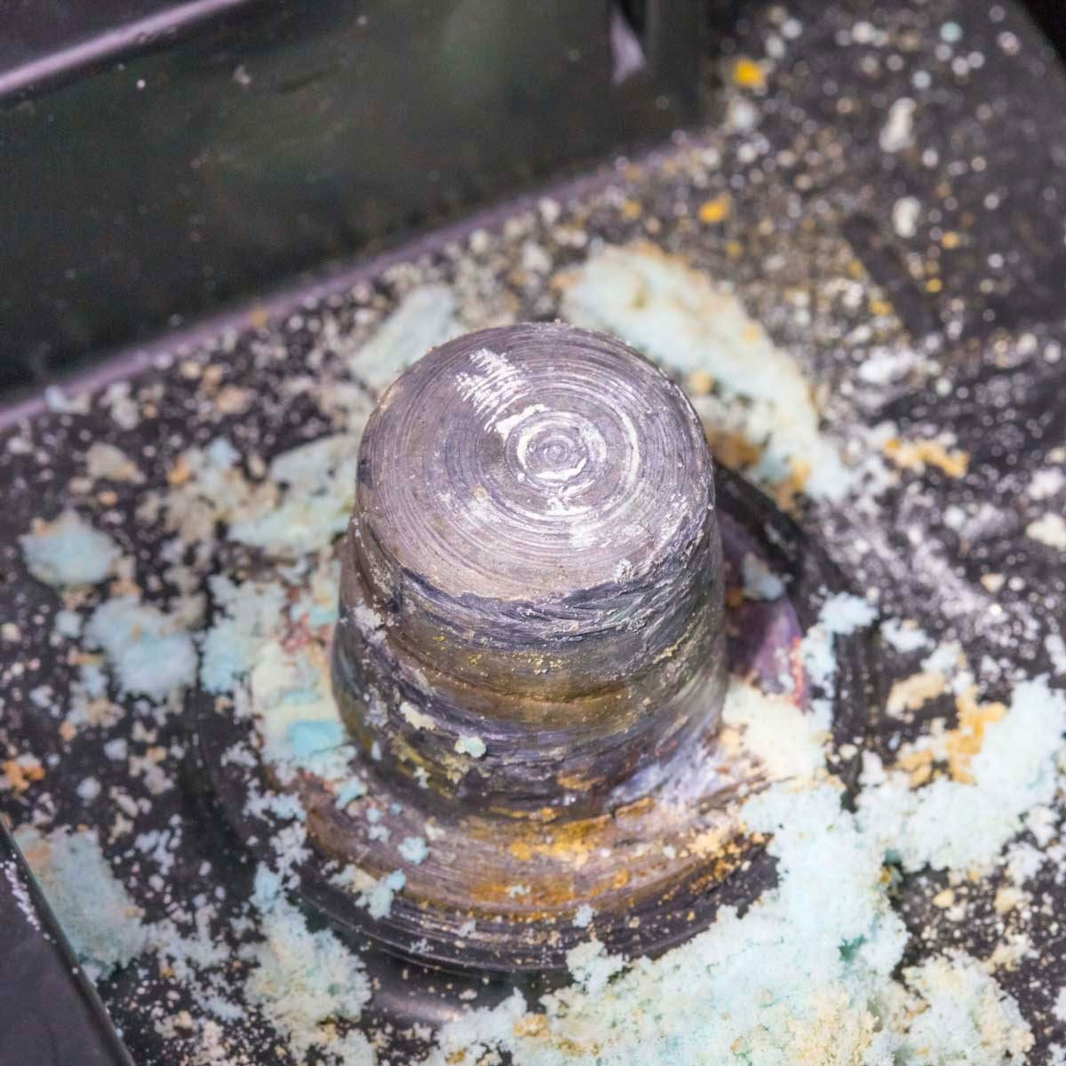
Batteries, One of the Most Common Causes of UPS System Failures.
Can lead to this…

Slide 34
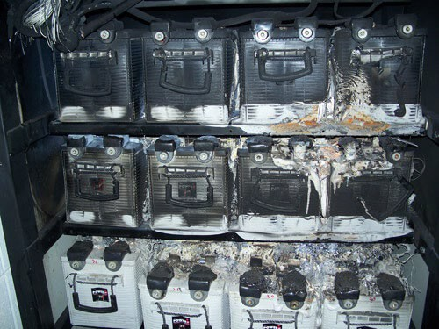
Batteries, One of the Most Common Causes of UPS System Failures.
And this…

Slide 35
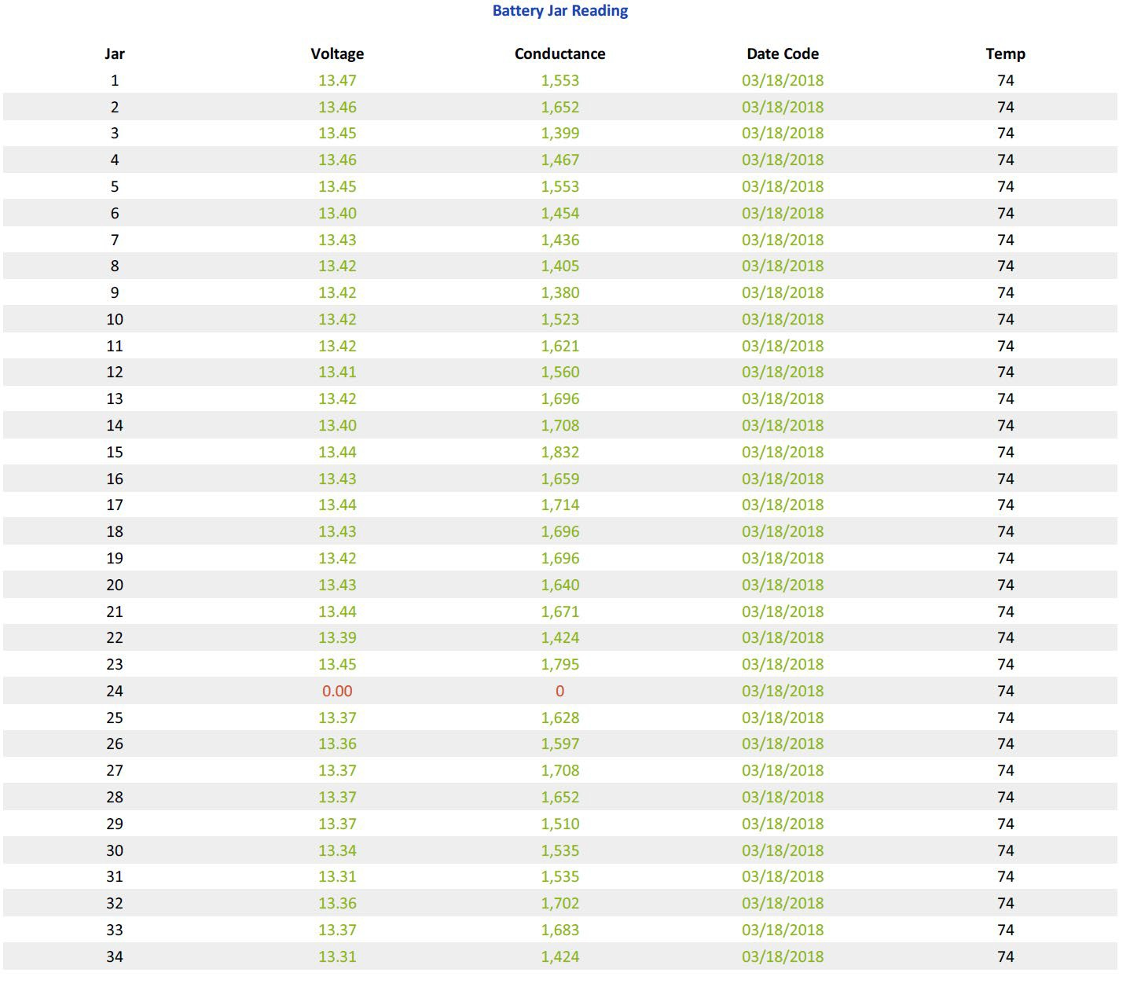
Routine Battery Testing a Must
It is highly desirable to test UPS batteries every 6 months. It should be noted that some newer UPS systems have built-in battery testing capabilities which can be programmed to operate on a specific schedule.
As is shown in the example here, Jar 24 has failed making this string and the UPS system at risk during a loss of utility power.
NOTE: These batteries where less than 3 years old at the time of this test.

Slide 36
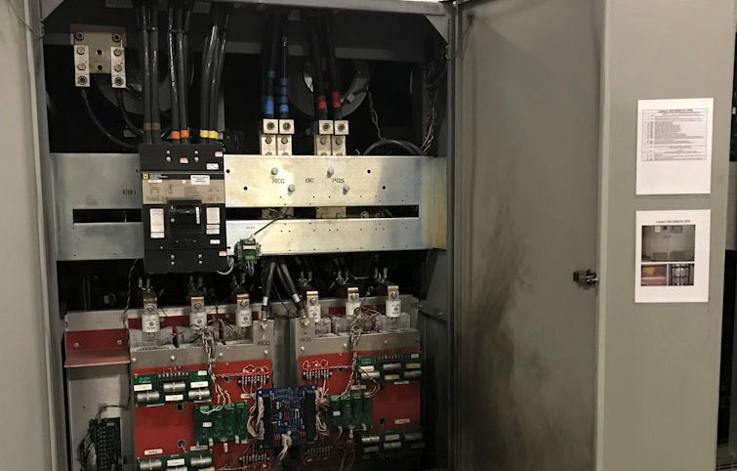
Capacitor Failures, What a Mess
While battery failures can cause a loss of power to the protected load, catastrophic capacitor failures can be far worse by causing extensive equipment damage.

Slide 37
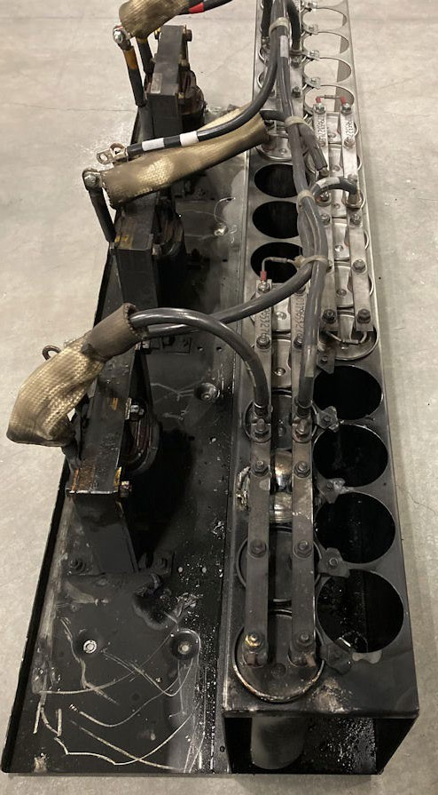
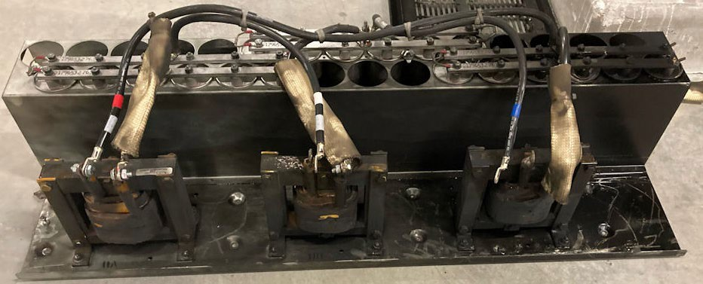
Input Filter Assembly
This was a failure in the “C” phase input filter (capacitors). This caused multiple component failures through out the UPS.

Slide 38
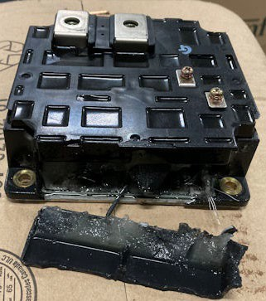
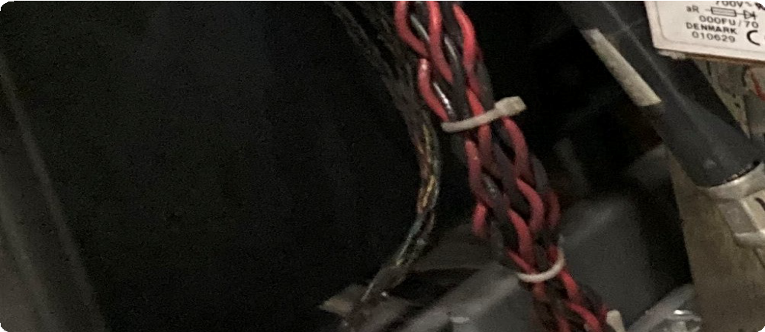
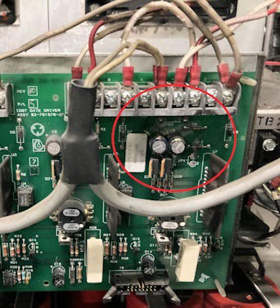
Additional Damage
Control cables, one of the inverter IGBT’s (insulated-gate bipolar transistor) along with the IGBT control board where damaged due to the failure of the filters/ capacitors.

Slide 39
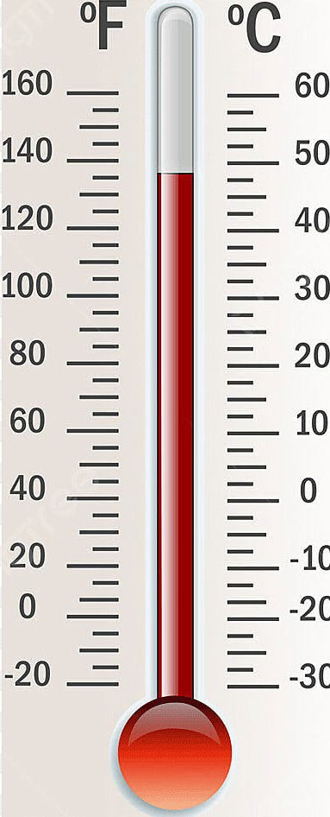
Root Cause Analysis (RNA)
Failure of an HVAC system, earlier in the year, had caused an elevated operating temperature in the UPS area over an extended period of time. It is believed the over temp condition greatly degraded the capacitors which lead to the failure. NOTE: The capacitors where only 3 years old at the time of the failure.

Slide 40
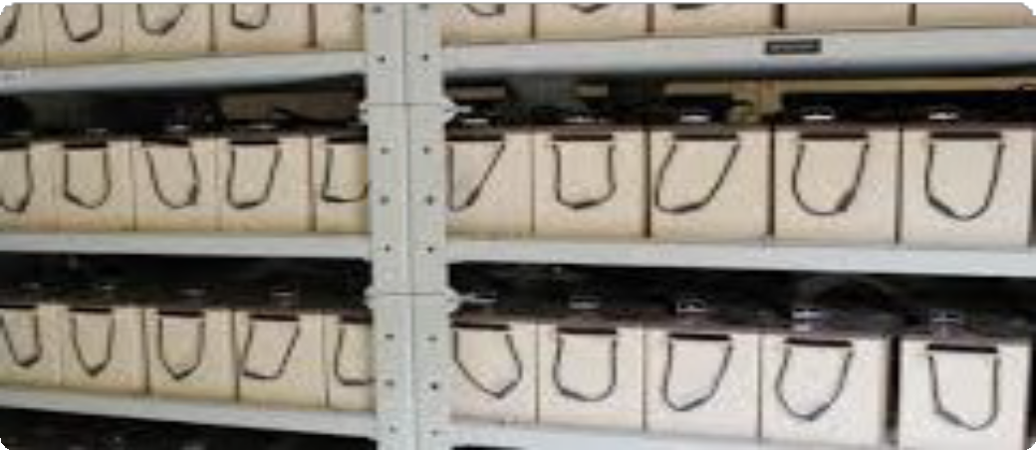
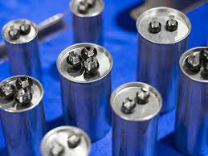
Routine Replacements of Batteries and Capacitors, a MUST.
Batteries, depending on make and model, may have a designed life cycle of 3 to 10 years.
Generally, UPS batteries should be part of a regular replacement schedule between 4 and 6 years. This is dependent on the battery design.
The industry standard for UPS capacitor life cycle is around 8 years.

Slide 41
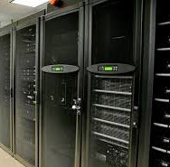
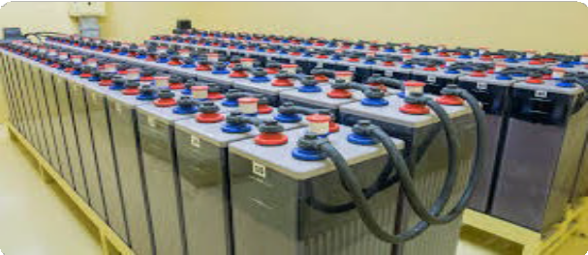
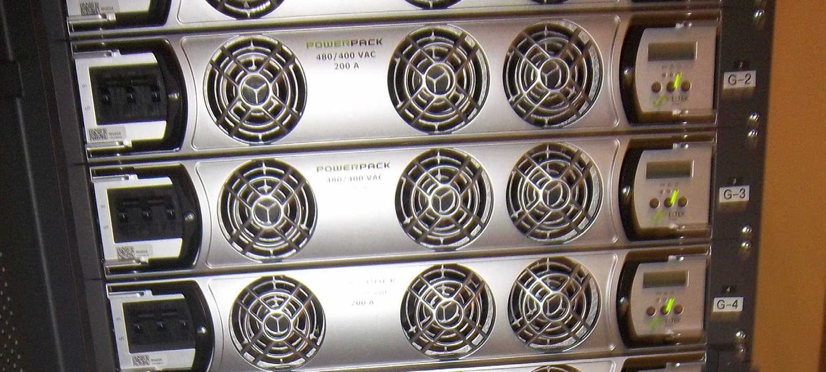
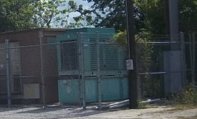
Conclusion
Regardless of the back- up power system(s) utilized. Correct sizing and long-term maintenance issues should be incorporated into the early planning stages for the best return on investment.

Slide 42
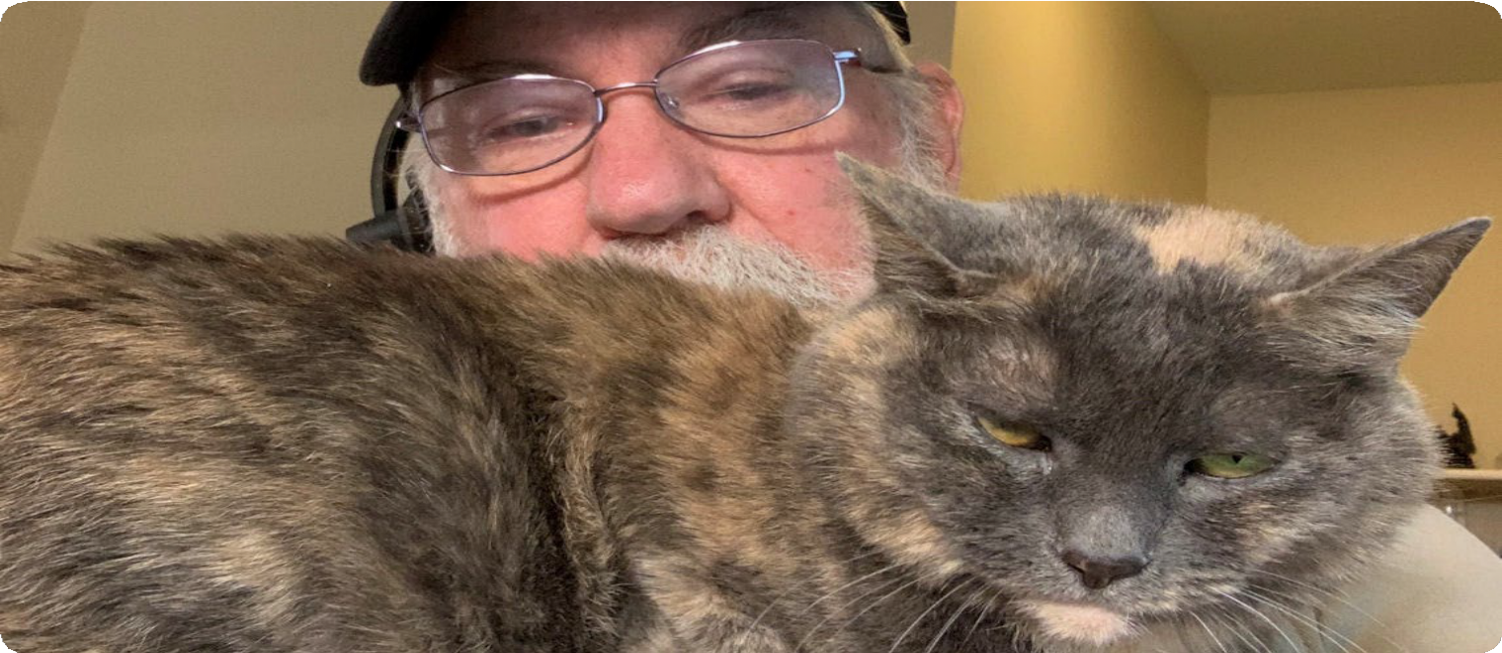
Special Thanks to My Office Manager!

Slide 43
Questions

