Slide 1
Generator and ATS
Ronald Slutter

Slide 2
Generator and ATS Contents
Typical Generator and Automatic Transfer Switch (ATS) Single Lines
Manual Transfer Switch (MTS) and Portable Generator Connections
Standard Vs. Bypass Isolation
Open, Closed and Delayed Transition ATS
Contactor Vs. Circuit Breaker Based Designs
When 4 Pole ATS is required
Generator Sub-base Tank Fuel Polishing

Slide 3
Typical Generator and Automatic Transfer Switch (ATS) Single Lines

Slide 4
Typical Single Generator and ATS
Represents the typical configuration.

Slide 5
Typical Dual Generator and ATS
Represents the most typical configuration with 2 generators and 2 ATS.

Slide 6
Manual Transfer Switch (MTS) and Portable Generator Connections

Slide 7
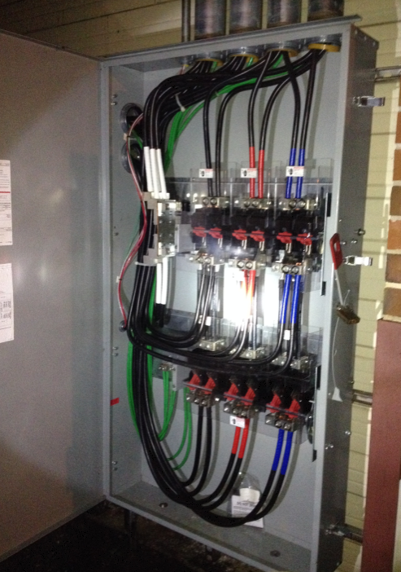
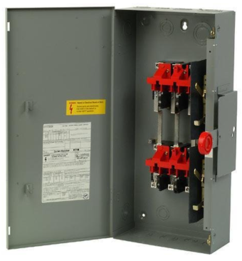
Portable Generator Connection Cabinet
Typically used to transfer power from portable generator to ATS. Allows very quick transfer from fixed generator to portable generator.
Typically connected to portable generator connection cabinet.
3 Pole or 4 Pole.
On – Off - On.

Slide 8
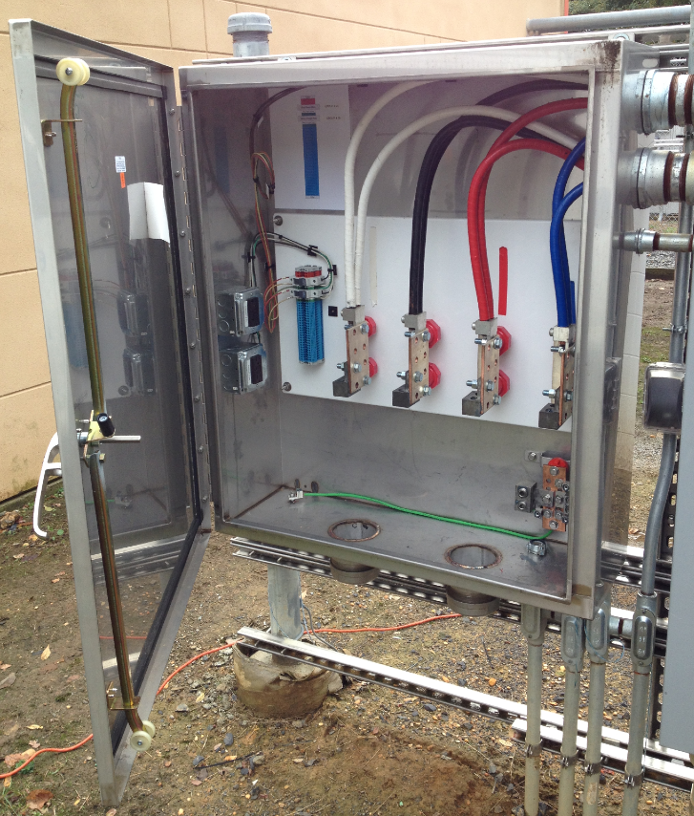
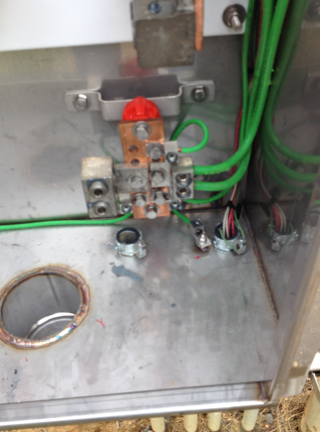
Portable Generator Connection Cabinet
Typically used to connect temporary cables from portable generator to MTS.
Provides power and controls for portable generator.

Slide 9
Triple Breaker Docking Station
Provides integrated connection for load bank and portable generator:
Phase rotation monitor
All aluminum NEMA 3R or stainless 4X construction
Patented tamper-resistant rake system to prevent cable theft and unauthorized disconnection
CamLok connections compatible with any rental generator or load bank for facility backup and permanent generator testing
Mechanical or Kirk Key interlock to safely disconnect and transfer power

Slide 10
Standard Vs. Bypass Isolation

Slide 11
ATS Standard
ATS mechanism does not have a bypass feature.

Slide 12
ATS Bypass Isolation
ATS mechanism has a bypass feature.

Slide 13
Open, Closed and Delayed Transition ATS

Slide 14
ATS Open Transition Standard
Open transition – Break Before Make
Not recommended but sometimes used – Creates a transient surge to the load.

Slide 15
ATS Delayed Transition Standard
Delayed Transition – Center Off
Often used – 5 second delay recommended. No Transient to the load

Slide 16
ATS Closed Transition Standard
Closed Transition – Make Before Break
Used with Utility Approval. Requires Advanced configuration.

Slide 17
ATS Open Transition Bypass Isolation
Open transition – Break Before Make
Not recommended but sometimes used – Creates a transient surge to the load.

Slide 18
ATS Delayed Transition Bypass Isolation
Delayed Transition – Center Off
Often used – 5 second delay recommended. No Transient to the load

Slide 19
ATS Closed Transition Bypass Isolation
Closed Transition – Make Before Break
Used with Utility Approval. Requires Advanced configuration.

Slide 20
Contactor Vs. Circuit Breaker Based Designs

Slide 21
Basic Contactor ATS Design
Typical contactor-based ATS switch design.
Rating contacts 200,000 cycles lifetime.

Slide 22
Basic Circuit Breaker ATS Design
Typical contactor-based ATS switch design.
Rating of Circuit Breaker Approx 300 Cycles per year.

Slide 23
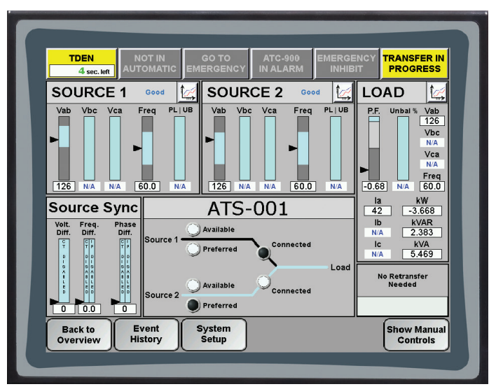
Basic Switchgear Circuit Breaker Design
Typical electrically operated circuit breaker based transfer switch design with HMI.

Slide 24
When 4 Pole ATS is required

Slide 25
NEC 230.95 Ground Fault Protection
Ground-fault protection of equipment shall be provided for solidly grounded wye electric services of more than 150 volts to ground but not exceeding 1000 volts phase-to-phase for each service disconnect rated 1000 amperes or more.

Slide 26
NEC 230.95 Performance Testing
The ground-fault protection system shall be performance tested when first installed on site.
This testing shall be conducted by a qualified person(s) using a test process of primary current injection, in accordance with instructions that shall be provided with the equipment.

Slide 27
3 Pole Solidly Grounded System

Slide 28
4 Pole Solidly Grounded System

Slide 29
3 Pole vs. 4 Pole Bonding Separately Derived Systems

Slide 30
Generator Sub-base Tank Fuel Polishing

Slide 31
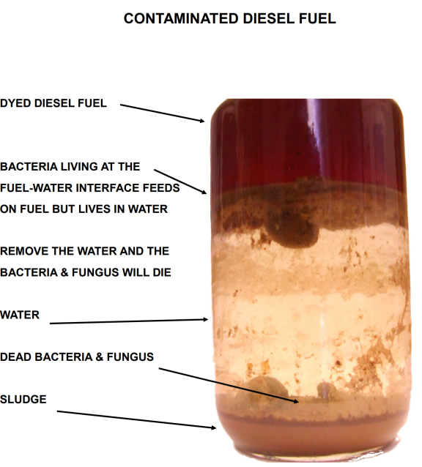
Sampling a Fuel Tank

Slide 32
Generator Diesel Fuel Polishing

Slide 33
Two Content Layout with SmartArt
First bullet point here
Second bullet point here
Third bullet point here
First bullet point here
Second bullet point here
Third bullet point here

Slide 34
Add a Slide Title - 2

Slide 35
Add a Slide Title - 3

Slide 37
Add a Slide Title - 4

Slide 38
Add a Slide Title - 5

