Slide 1
Panel Discussion Evolution of Telecommunications – Role of Traditional Telcos & Manufacturers Going Forward

Slide 2
CO / Data Center Evolution How to Power Pizza Ovens Steve Martin, P.E. AT&T

Slide 4
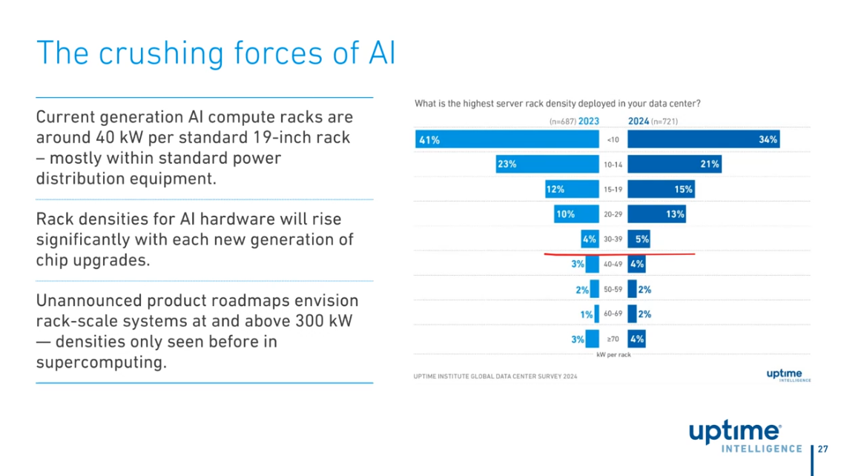
15kW
25kW

Slide 6
